Slide 1

MARKING AND PAYMENT OF FILING FEES
SMALL CLAIMS COURT
Presented by
Olawale Adeliyi, esq.
Banwo & ighodalo
May 2023

Slide 2
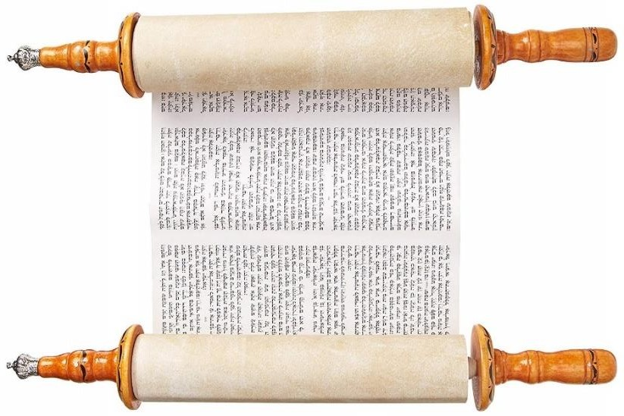
OUTLINE
Introduction
What is a Small Claims Court?
Small Claims Practice Directions
Templates
  Letter of Demand
  Complaint Form
  Summons
Marking
Payment of Filing Fees
Parties involved in Marking & Filing Processes
Conclusion
2

Slide 3

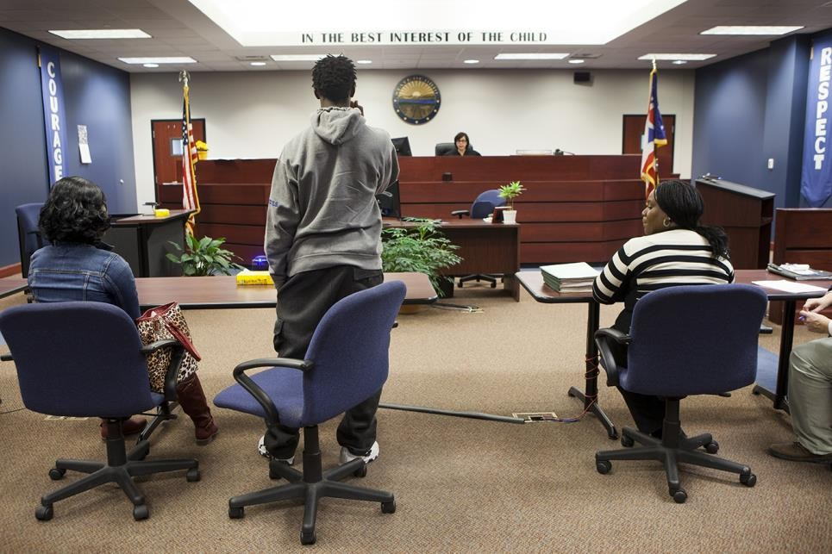
Introduction
The Small Claims Court is designed to provide judicial determination of disputes involving small amounts of money or simple liquidated money demand.
Its procedure is significant for economic expediency, speed, informality and simplicity.
The foregoing objectives cannot be achieved without a responsible support staff with the right attitude.
3

Slide 4


What is a Small Claims Court?
4

Slide 5
What is a Small Claims Court?
A Small Claims Court is a local court/tribunal in which claims for small sums of money can be heard and decided quickly and cheaply, with/without legal representation.
5

Slide 6
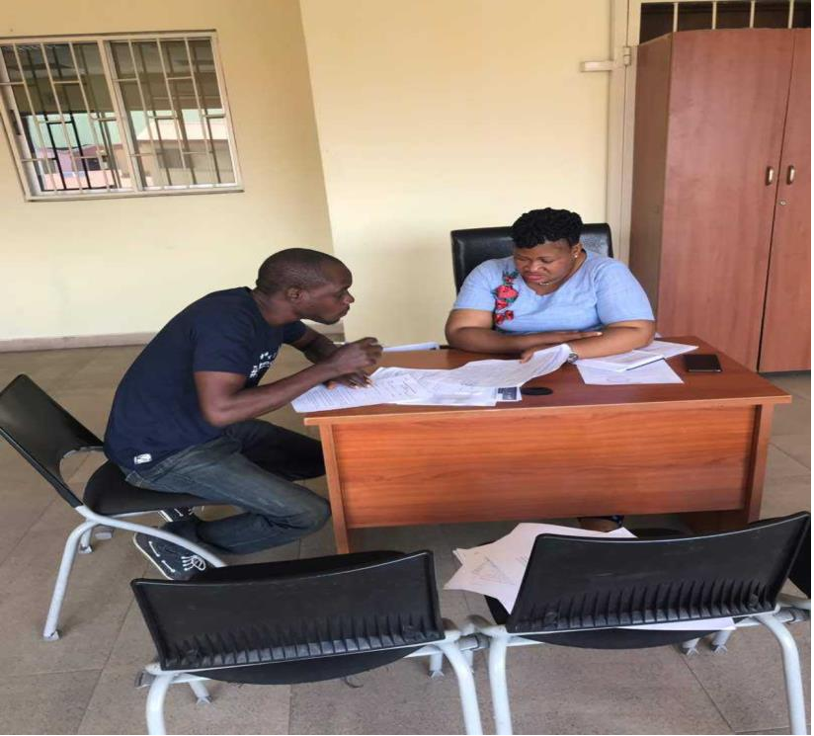
Small Claims Court Practice Directions
As part of efforts to fast track justice delivery in commercial dispute involving small claims, Delta State has inaugurated its Small Claims Courts.
The Small Claims Court has a specialized registry and staff mandated to carry out the objectives of the Small Claims Court Practice Direction.
5

Slide 7
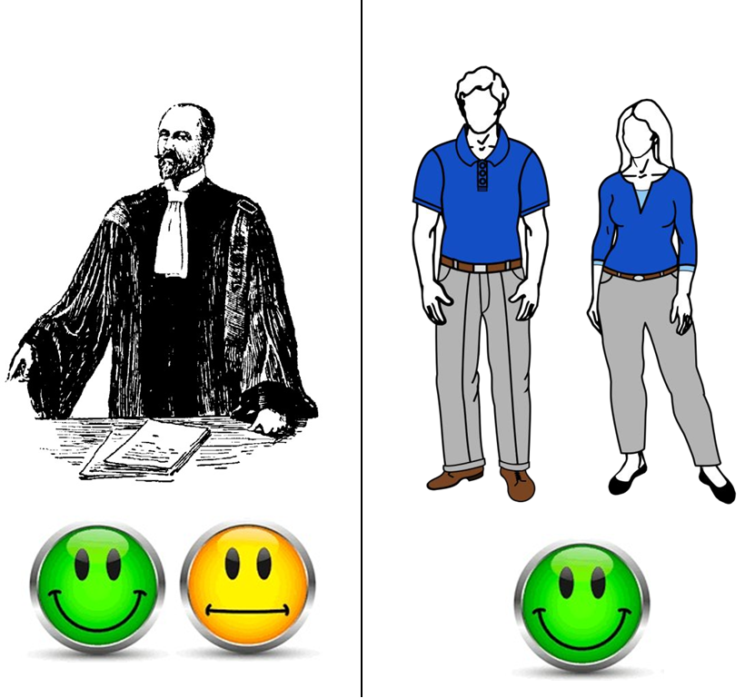
Small Claims Court Practice Directions
The usual guiding principle in the Small Claims Court is that individuals ought to be able to conduct their own cases and represent themselves, possibly without a lawyer.
Of course filing will be done by the litigants, with the assistance of the Registrar and/or any other person in charge.
5

Slide 8
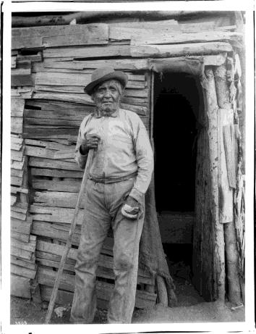

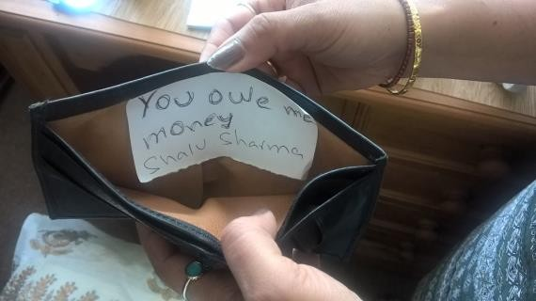
Small Claims Court Practice Direction
An action may be commenced in the Small Claims
Court where:
The Claimant or one of the Claimants resides or carries on business in Delta State;
The Defendant or one of the Defendants resides or carries on business in Delta State;
•
The cause of action arose wholly or in part in Delta State;
•
The claim is for a liquidated money demand in a sum not exceeding NGN5,000,000 excluding interests and costs; and
•
The Claimant has served on the Defendant, a Letter
of demand –Form SCC 1.
•
8

Slide 9
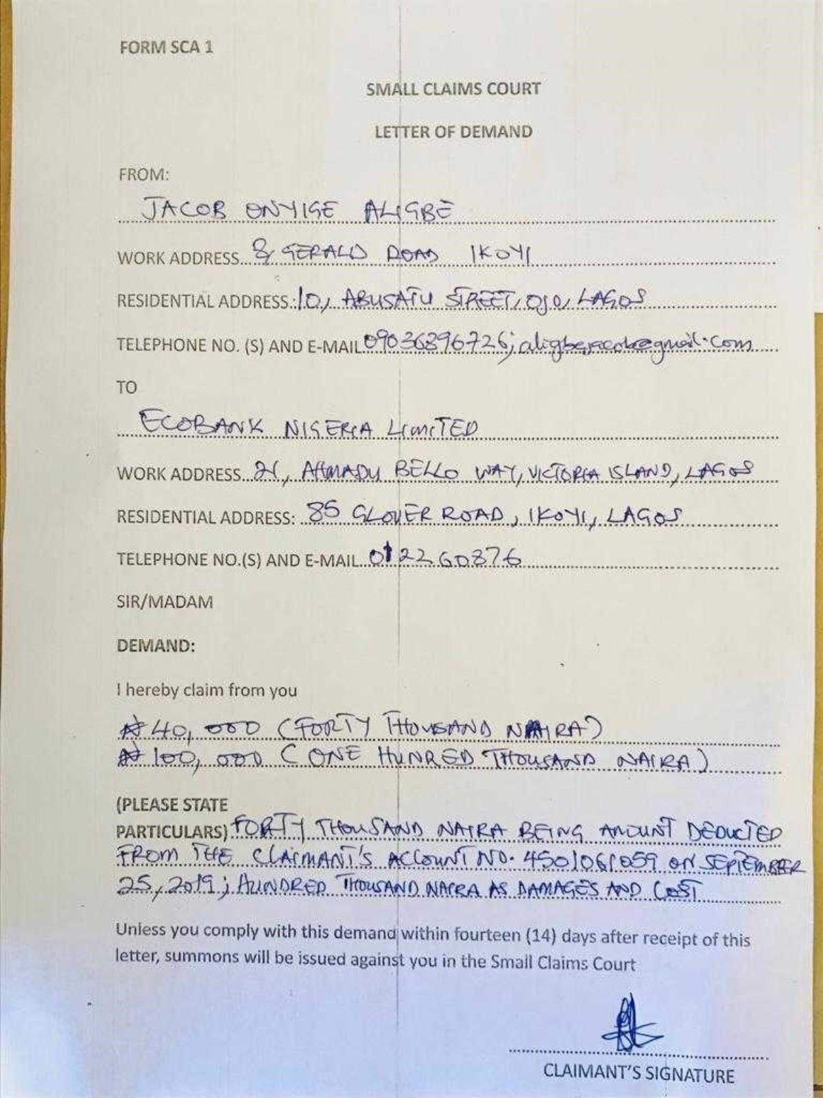
FORM SCC 1-LETTER OF DEMAND
8

Slide 10

Small Claims Court Practice
The action shall be commenced upon completion of a Small Claims Complaint Form as in Form SCC 2, following which the Registrar will issue Form SCC 3.
8

Slide 11
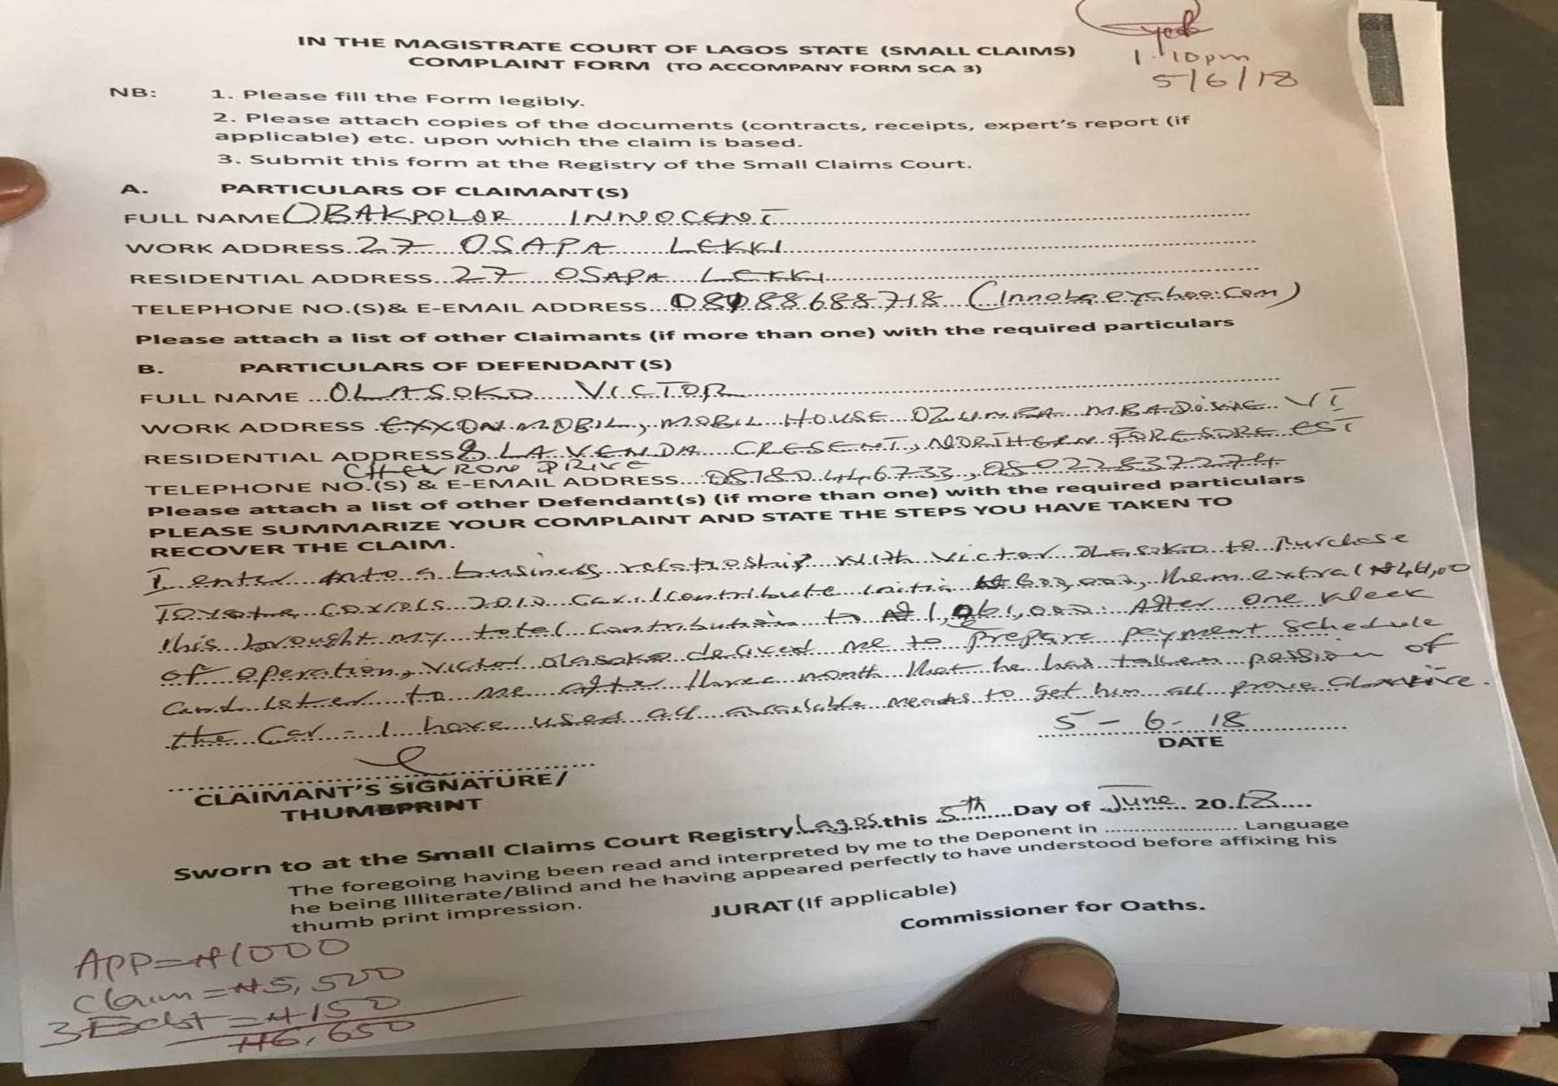
FORM SCC 2
Complaint Form

Slide 12
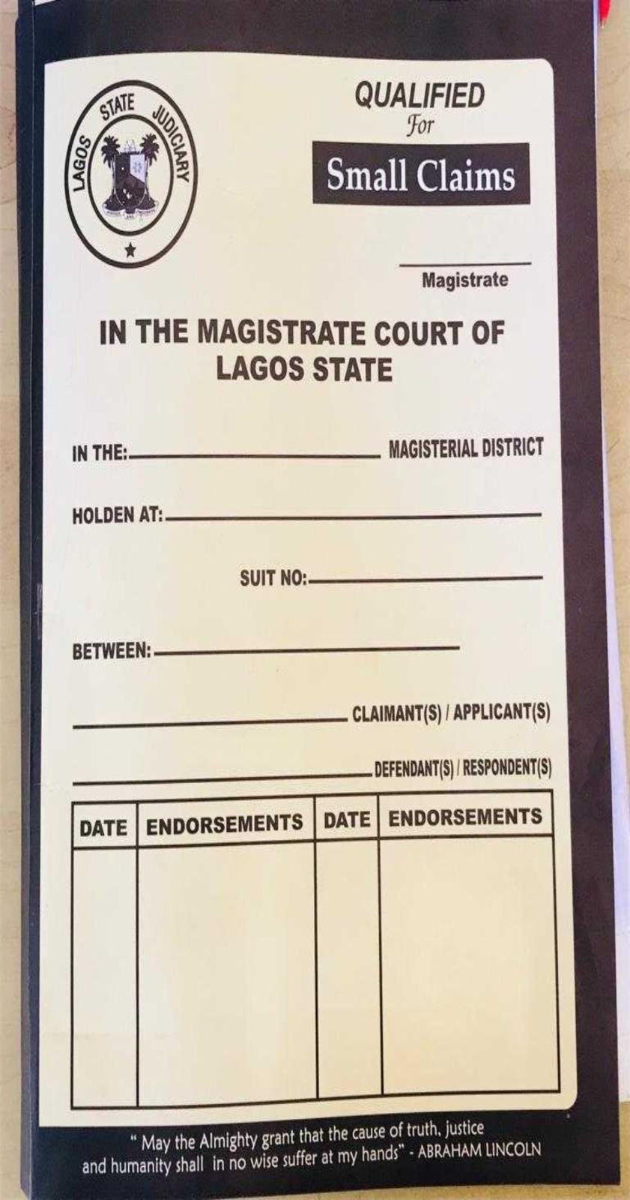
Small Claims Court Practice/Procedure
Marking
Marking
The very essence of marking is to register claims that have complied with all the provisions set out in the Article 2 of the Delta State Small Claims Court Practice Directions, 2023.

Slide 13
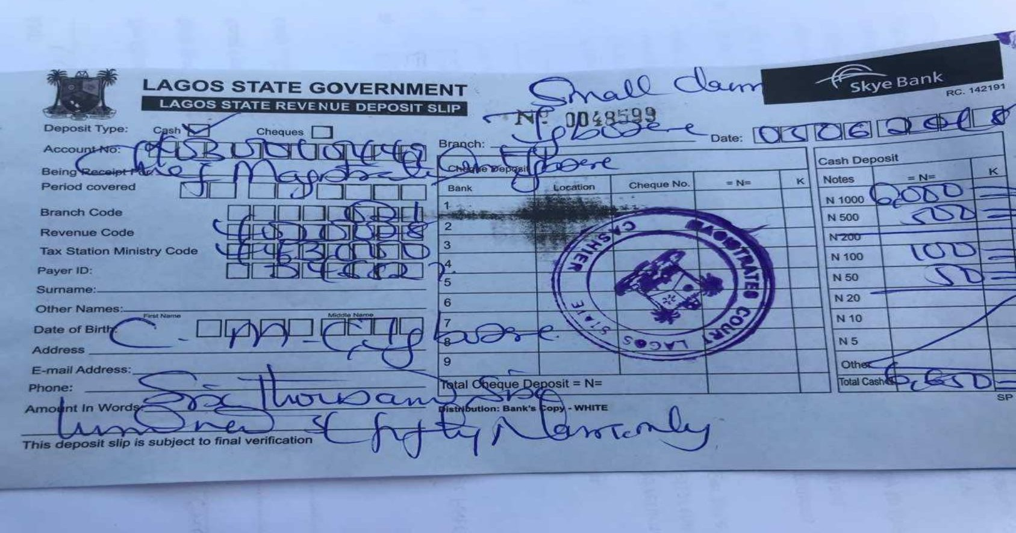
Payment of Filing Fees
Payment of filing fees is regulated by Article 3 of the Practice Directions
The Registrar in charge of the Small Claims Registry shall cause the Claim to be marked “Qualified for Small Claims” and direct the Claimant to pay appropriate filing fees.
8

Slide 14



Payment of Filing Fees
The Registrar/Assistant Chief Registrar/other person in charge – has the duty of ensuring that all has been complied with. He is also in charge of supervision of the entire process, including scrutinization of the necessary forms.
The Assistant Chief Registrar in charge of the Small Claims Court– has the duty of endorsing a claim with the words “Qualified for Small claims” and to forward the case files to the Administrative Magistrate for assignment.
Any other person in charge of the Small Claims Registry – an auxiliary role by court officials to ensure that there is no delay in the filing.
8

Slide 15

The Small Claims Court Registry is the litigants’ first point of contact and court officials should be prepared to assist litigants with the filing procedures. Therefore, It is important for court officials to be diligent, responsible and display the right attitude.
16

Slide 16

17

